Slide 1
بسم الله الرحمن الرحیم
Intrapartum Fetal Monitoring
Dr. Zahra Fardiazar
OB&GYN
Fellowship of Perinatology
1399

Slide 2
Fetal assessment
The primary goal of FHR monitoring is to identify hypoxemic and acidotic fetuses and secondary goal is to avoid fetal neurologic injury, if possible
FHR monitoring is only part of the overall clinical assessment. There are other non-hypoxic factors causing fetal injury such as bleeding meconium staining…

Slide 3
Pathophysiology of FHR patterns
Slowing FHR due to firing vagus nerve
Slowing FHR due to myocardial depression by lactate from anaerobic metabolism(hypoxia)
Increased FHR caused by fetal released of catecholamine's and stimulation of sympathetic nervous system
The parasympathetic system develops later and consequently preterm fetus tends to have higher baseline rates.
Conversely, for a postdate fetus a lower baseline rate is to be expected

Slide 4
Physiology of Hypoxia in Labour

Slide 5
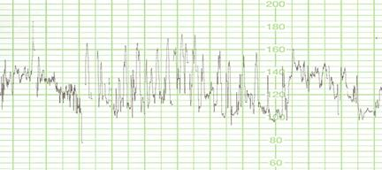
Transient, mild hypoxemia associated:
by stimulating the sympathetic system, increases the FHR and variability
If hypoxemia persists or worsens,
By vagal stimulation, lead to slows the FHR

Slide 6
As hypoxemia worsens,
accelerations disappear and non reactivity of the NST
Prolonged and/or severe hypoxia:
(decelerations become wider and deeper) with a reduce baseline variability
If oxygen deprivation progresses:
Couse to fetal metabolic acidemia, the fetus may exhibit late decelerations or bradycardia due to direct myocardial depression

Slide 7
Baseline rate
Normal = 110 to 160 bpm
the mean bpm (rounded to 0 or 5)
10-minute interval
excluding periodic changes, periods of marked variability
identifiable for two minutes during the interval

Slide 8
It is important to consider the trend of the baseline FHR over time
Hypoxic stress result increase in catecholamin level and increase FHR from start of CTG although baseline is still within normal range

Slide 9
NICE PROTOCOL
Description | Reassuring | Non-reassuring | Abnormal
Baseline (beats/ minute | 110 to 160 | 100 to 109 or 161to 180 For 30-80 m | Below 100 Or Above 160 for more than 80 m Or Above 180

Slide 10
Variability
The normal variability is 5-25 bpm( in every 1 minute), seen of 24-28 w
complete loss :associated with previous or ongoing brain damage and sometimes due to depressant drugs
Moderately reduced: <5 but >2 to be seen for up to 40 m during quiet sleep (it is significant for more than 50 minutes in
baseline segments, or for more than 3 minutes during decelerations. FIGO 2015)
Increased variability or saltatory pattern: amplitude > 25
in a 10-m:
it may be seen
oxytocin use
mother pushing
with recurrent decelerations, when hypoxia/acidosis evolves very rapidly
A saltatory pattern for more than 30 m may indicate hypoxia even without decelerations.

Slide 11
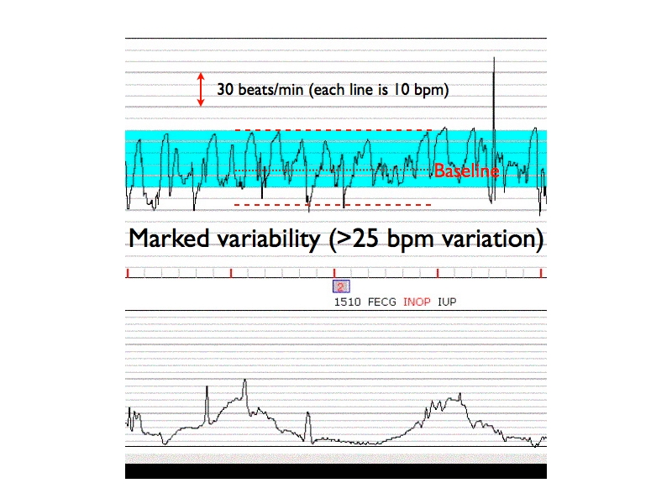
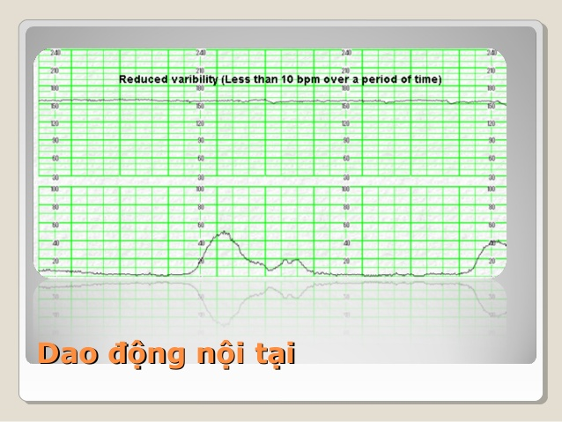

Slide 12
Description | Reassuring | Non-reassuring | Abnormal
Baseline variability (beats/ minute) | 5 to 25 | Less than 5 for 30 to 50m OR More than 25 for 15 to 25m | Less than 5 for more than 50 m OR More than 25b for more than 25 m OR Sinusoidal

Slide 13
Acceleration
they are usually associated with fetal movements
Its absence during
late labor
Maternal pushing in 2 stage of labor
hypoxic stress

Slide 14
early decelerations
They are benign but also rare,2% of all decelerations
occurring in early labor
it is more likely that ‘shallow’( decelerations secondary to chronic hypoxia are being misclassified as ‘early decelerations )

Slide 15
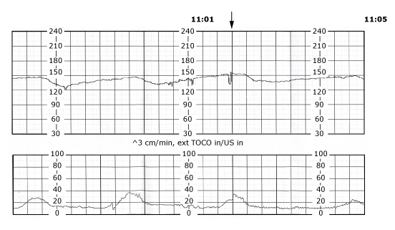
Late deceleration:
Typically LD fall at least 20 bpm and rarely fall below 30-40 pbm

Slide 16
Description | Reassuring | Non-reassuring | Abnormal
decelerations | None or early | Late decelerations in over 50% of contractions for less than 30 m, with no risk factors (vaginal bleeding or significant meconium) | Late decelerations for 30 m (or less if any risk factors) OR Acute bradycardia, or a single prolonged deceleration lasting 3 minutes or more

Slide 17
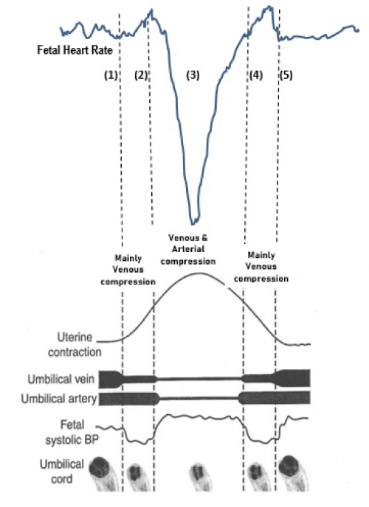
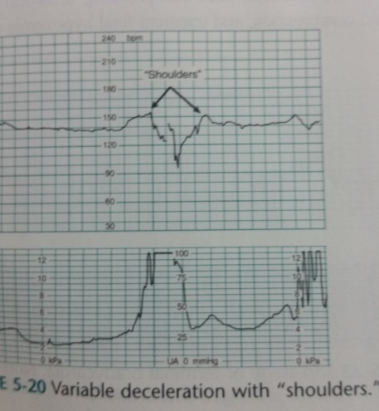

Slide 18
concerning characteristics of variable decelerations
They are seldom associated with fetal hypoxia/acidosis
Reflect an intense and prolonged umbilical compression:
Increasing depth>60
lasting more than 60 seconds
reduced baseline variability within the deceleration
failure to return to baseline
biphasic (W) shape
no shouldering
overshoot

Slide 20
W pattern (biphasic deceleration)

Slide 21
Description | Reassuring | Non-reassuring | Abnormal
Variable decelerations | None or VD with no concerning characteristics for < 90m | VD with no concerning characteristics for$≥$ 90 m OR VD with any concerning characteristics in up to 50% of contractions for $≥$30 m OR VD with any concerning characteristics in over 50% of contractions for less than 30 minutes | VD with any concerning characteristics in over 50% of contractions for 30 m or less if any maternal or fetal clinical risk factors

Slide 22
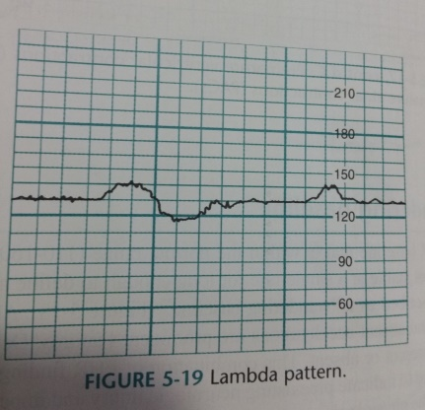
Lambda pattern
Is characterized by a brief acceleration followed by a small deceleration
Common during early labor
No clinical significant
Underlying physiologic mechanism is not known

Slide 23
Saltatory baseline fetal heart rate showing rapidly recurring couplets ...

Slide 24
Saltatory fetal heart rate pattern
rapidly recurring couplets of acceleration and deceleration that amplitude changes of greater than 25 beats per minute with an oscillatory frequency of greater than 6 per minute for a minimum duration of 1 minute
most often seen during the second stage of labor
usually caused by acute hypoxia or mechanical compression of the umbilical cord
The presence of a saltatory pattern with decelerations, should warn of hypoxia is progressing to acidosis

Slide 26
Wandering Baseline pre-terminal pattern
FHR baseline that is within the normal range (110 to 160 )but not stable at a single rate long enough
Absent variability and absent accelerations
decelerations may be present or absent.
indicate preexisting neurologic injury and impending fetal death
The physiologic mechanism is not known

Slide 27
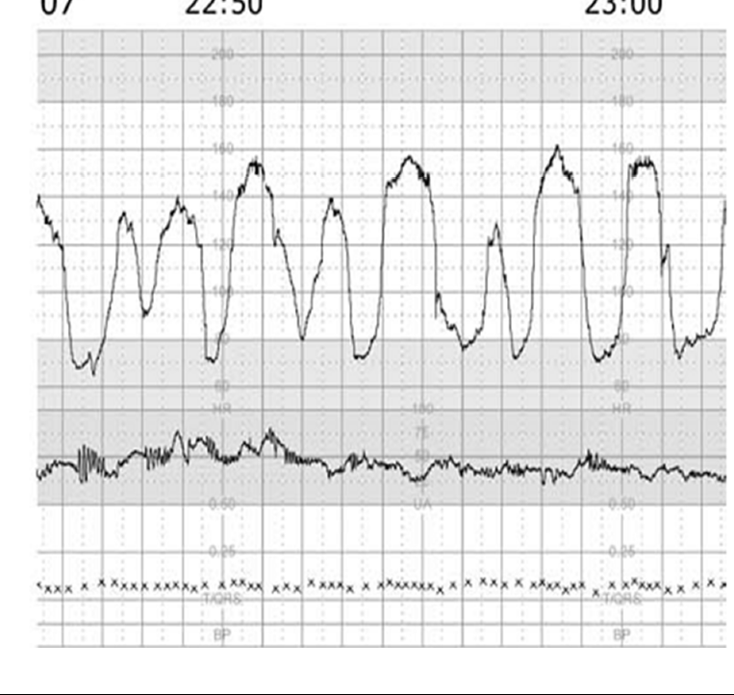

Slide 28
Sinusoidal heart rate pattern
defined as a regular variability resembling a sine wave with a fixed periodicity of three to five cycles per minute
An amplitude of 5 to 10 bpm
lasting for at least 10 minutes accelerations.
Beat to beat changes are often small
It occurs in association with severe fetal anaemia, fetal hypoxia, infection, cardiac malformations ,hydrocephalus, and gastroschisis

Slide 29
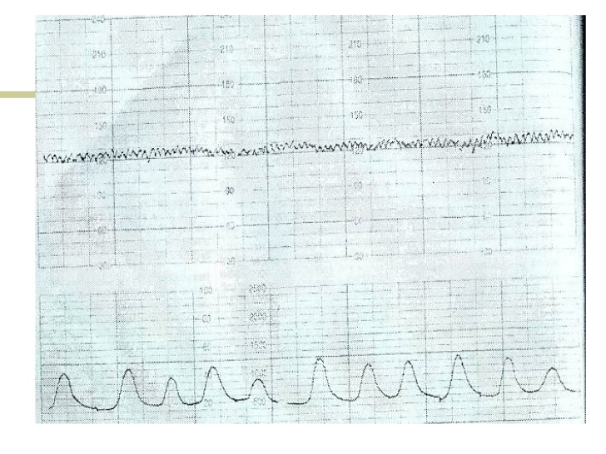

Slide 30
Pseudo-sinusoidal pattern
A pattern appearance as “saw-tooth ”, rather than the smooth sine-wave form
Its duration seldom exceeds 30 minutes and
it is characterized by normal patterns before and after this
Normal Variability
Some authorities consider as the presence of accelerations with sinusoidal patterns
caused by
fetal hypotension occurring secondary to acute feto-maternal haemorrhage
after analgesic administration to the mother
during periods of fetal sucking

Slide 31
Pseudosinusoidal Fetal Heart Rate Pattern

Slide 32
Prolonged deceleration
A decrease in FHR below the baseline of 15 bpm or more, lasting at least 2 minutes but <10 minutes from onset to return to baseline. A prolonged deceleration of 10 minutes or more is considered a change in baseline.
When the FHR falls below 100, tissue perfusion may not be adequate; this degree of bradycardia is abnormal even when variability is present since it may be due to an acute adverse event.

Slide 33
Category I (Normal): Tracings with all these findings present normal and can be followed in a standard manner:
Baseline rate 110–160 bpm,
Moderate variability,
Absence of late or variable decelerations,
Early decelerations and accelerations may or may not be present.
Category II (Indeterminate): Tracing is not predictive of abnormal fetal acid-base status. Evaluation and continued surveillance and reevaluations are indicated.
Category III (Abnormal): Tracing is predictive of abnormal fetal acid-base status at the time of observation; this requires prompt evaluation and management.
Absence of baseline variability, with recurrent late/variable decelerations or bradycardia; or
Sinusoidal fetal heart rate.

Slide 34
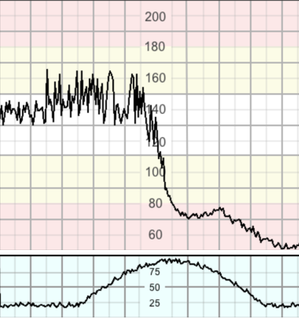
Acute Hypoxia
Presents as a prolonged deceleration lasting for more than 5 minutes or for more than 3 minutes if associated with reduced variability within the deceleration
• Causes
3 Accidents
Cord prolapse
Placental Abruption
Uterine Rupture
2 Iatrogenic
Maternal Hypotension (usually secondary to supine or epidural top-up)
Uterine hyperstimulation (by oxytocin , PGs, spontaneous increased activity

Slide 35
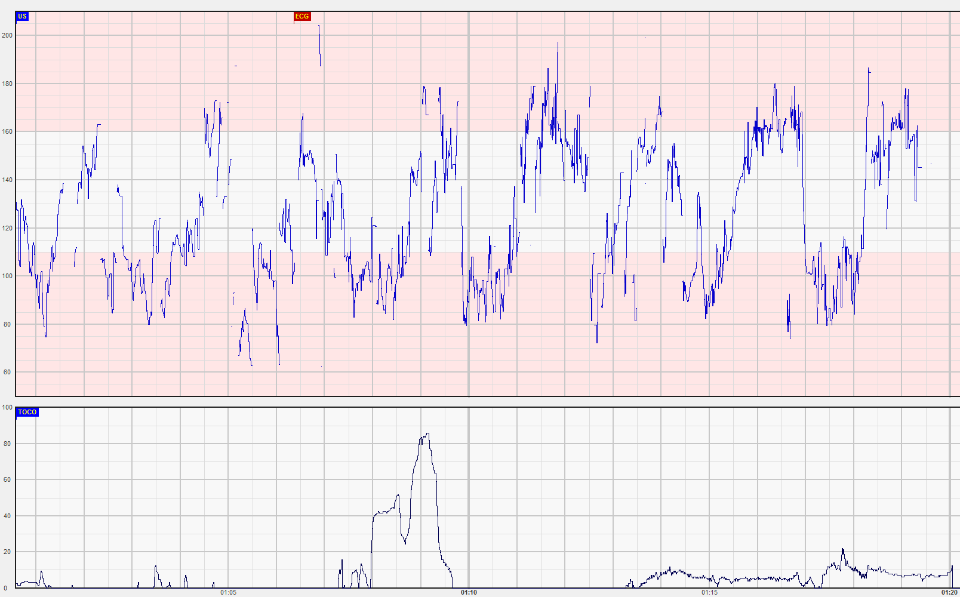
Subacute Hypoxia
More time spent during decelerations than at the baseline
May be associated with saltatory pattern
almost caused by uterine hyperstimulation

Slide 36
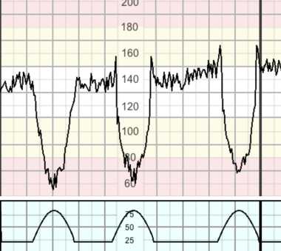
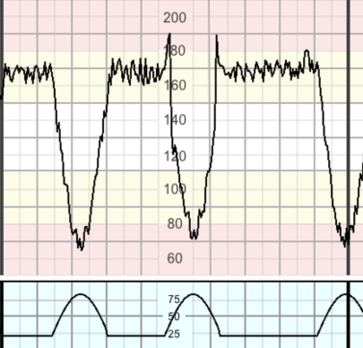
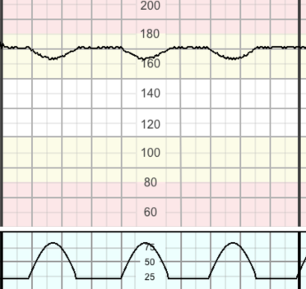
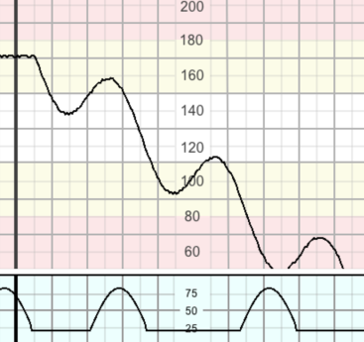
Gradually Evolving Hypoxia
This is the most common type of hypoxia in labour
1. deceleration
2. Loss of accelerations and lack of cycling
3. decelerations become wider and deeper)
4. rise in baseline
Compensated
conservative interventions • Regular review every 30-60 minutes
5. reduced baseline variability
6. Terminal heart failure (unstable/ progressive decline in the baseline - “step ladder pattern to death”)
Decompensated
Needs urgent intervention

Slide 37
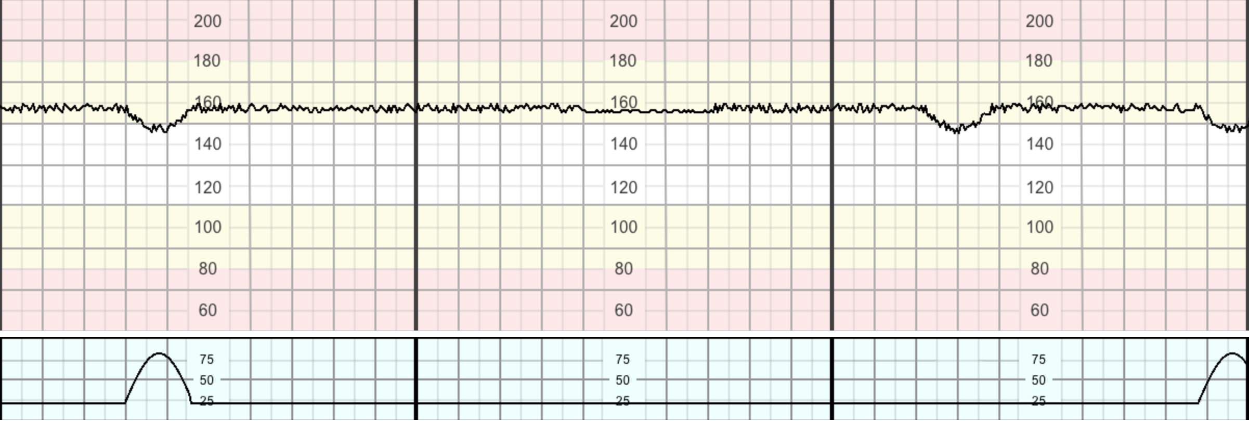
Chronic Hypoxia
baseline rate at the upper end of normal
reduced variability
lack of accelerations and cycling
shallow decelerations.
surgical intervention.

Slide 38
Higher baseline than expected for G.A.
Reduced variability and/ or absence of cycling
Absence of accelerations
Shallow decelerations
Consider the clinical indicators: reduced fetal movements, thick meconium, bleeding,evidence of chorioamnionitis, postmaturity,IUGR
Avoid further stress
Expedite delivery, if delivery is not imminent

Slide 39
Important note
Be aware that if the CTG parameters of baseline fetal heart rate and baseline variability are normal, the risk of fetal acidosis is low and according to both NICE and FIGO guidelines, no intervention is required other
than careful observation.
Due to the longer half-life of prostaglandins, hyperstimulation usually requires the removal of the pessary and administration of tocolytics at the same time, especially when dealing with acute hypoxia

Slide 40
automatic CTG assessment
using a computerized analysis of fetal heart rate variability with the aim of obtaining an objective assessment in the shortest possible time (minimum 10 min). The data obtained was correlated with outcome criteria and it was shown that achieving the Dawes/Redman criteria was a significant indicator that the fetus was not at risk

Slide 41
Criteria indicating that the fetus is not at risk include:
short-term variation (short-term variation, STV) > 4 m
STV measures variations in the mean absolute difference in time between consecutive heart beats; this data can only be obtained from computer readings),
no sinusoidal rhythms,
at least one episode of higher FHR variation,
no deep or repeated FHR decelerations,
FHR accelerations and/or fetal movements,
normocardia.

Slide 42
Studies on and experience with the use of mobile CTG devices used for telemedical home monitoring have consistently shown that the technique is safe and use of mobile CTG devices is associated with high patient satisfaction.

Slide 43
ST segment analysis (STAN)** with direct fetal ECG
An increase in T-wave amplitude is the result of increased glycogen depletion in fetal myocardial cells during metabolic acidosis. The T/QRS ratio increases as fetal hypoxia increases with consequent metabolic acidosis during labor. The method can be used for intrapartum monitoring after the 36th week of gestation (contraindications for STAN with its use of a fetal scalp electrode are the same as those listed for FBA).
FHR must be analyzed together with any ST events to draw clinical conclusions.

Slide 44
For pregnancies at chronic risk, it is prudent to use additional monitoring methods with longer advance warning times, such as Doppler sonography, ultrasound evaluation of amniotic fluid volume, or KCTG to measure fetal movement. The high false-positive rate of up to 60 % reported for CTG caused by numerous sources of disturbance and other influencing factors can be reduced by the additional use of Doppler sonography, longer FHR recording times, or fetal stimulation

Slide 45
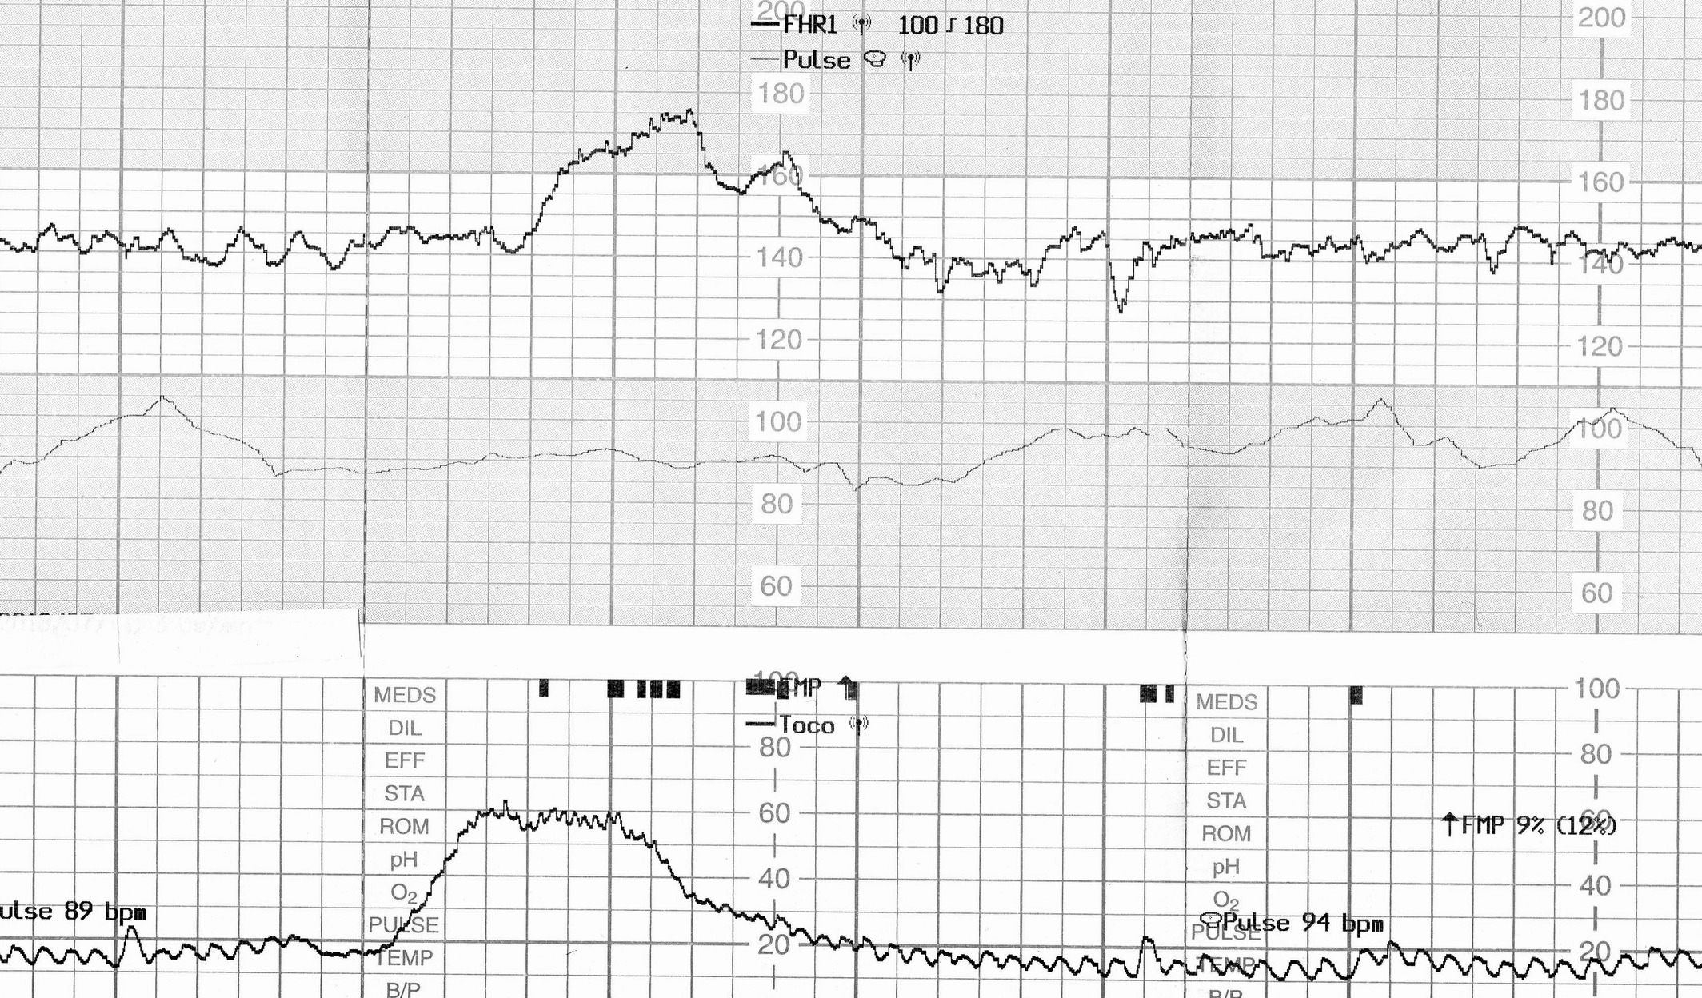
CASE PRESENTATION
A 30‐year‐old woman (gravida 3 para 1) was admitted for elective repeated caesarean delivery at 38 weeks
woman reported of feeling decreased fetal movements from 3 days prior to admission. She also had weak uterine contractions
CTG showed normal

Slide 46
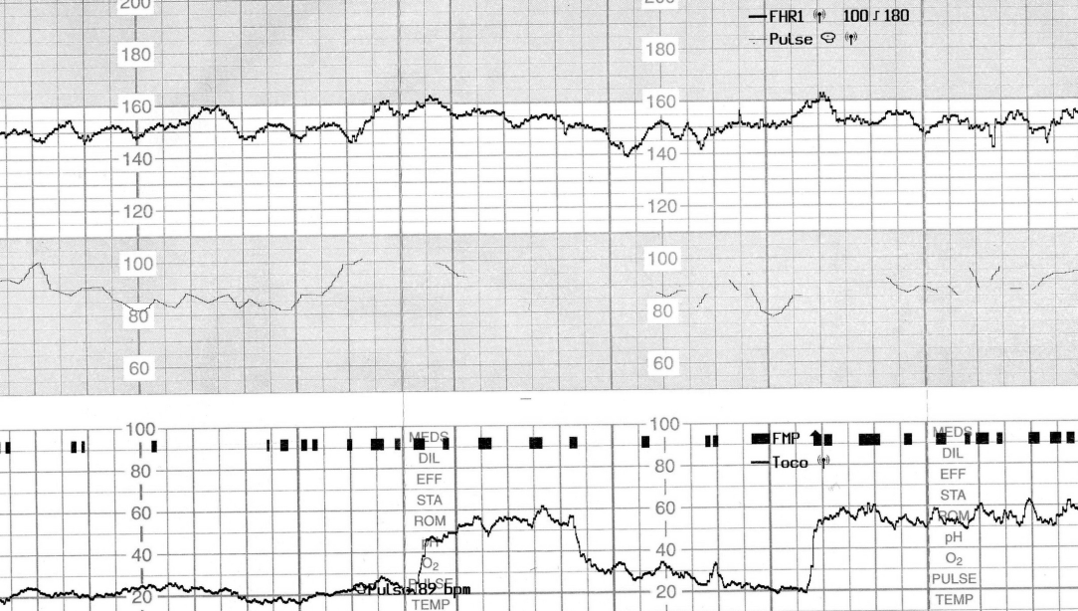
Four hours later, the baseline variability decreased, and the acceleration became unclear

Slide 47
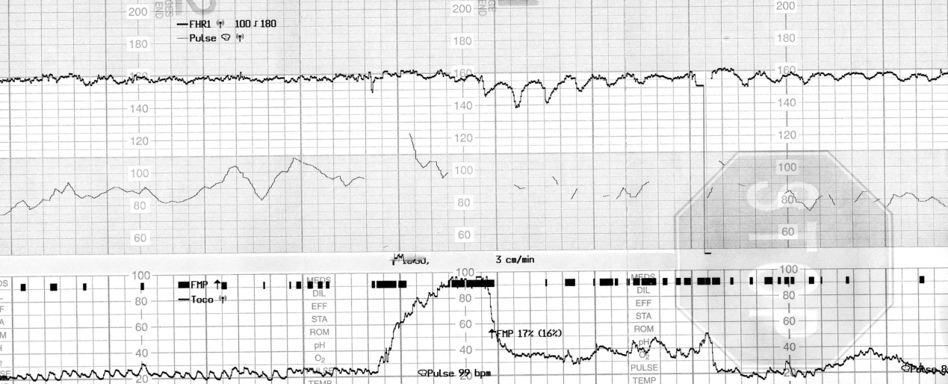
40 minutes later, a late deceleration and sinusoidal heart rate‐like findings were observed following weak uterine contraction

Slide 48
Cesarean section was performed, and a 2746‐g pale, female infant was delivered with Apgar scores of 7 and 8 at 1 and 5 minutes
the hemoglobin concentration was 4.2 g/dL (normal: 13‐22 g/dL) with reticulocyte counts of 19.0% (normal: diagnosed was fetomaternal hemorrhage.

Slide 49
acute blood loss with normal reticulocyte level, increases in variability have been observed in response to acute hypoxia
SHR pattern may also indicate the late‐staged fetal anemia
At admission in the current case, the baseline variability in CTG had been maintained in the absence of fetal distress; however, the hypoxia due to uterine contractions progressively reduced the baseline variability and caused the SHR pattern on CTG

Slide 50
continuous CTG or re‐monitoring of CTG should also be considered. In addition, the contraction stress test may be useful for the differential diagnosis of early‐stage chronic fetomaternal hemorrhage with reassuring fetal status on the CTG.
Maier JT, Schalinski E, Schneider W, Gottschalk U, Hellmeyer L. Fetomaternal hemorrhage (FMH), an update: review of literature and an illustrative case. Arch Gynecol Obstet. 2016; 292: 595

Slide 51
2
A 32 year old G1 P1 woman presented to our Institution for
evaluation at 38 + 4 wks gestation.
She was aected by hypertension under specic therapy that kept
blood pressure parameters under contro
A color Doppler velocimetry was performed two
weeks before showing, as stated in the report taken under vision, a
normal ultrasound examination

Slide 52
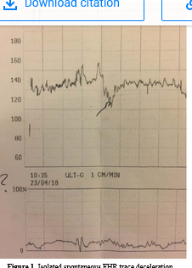
Aer a 40 minutes CTG trace, one single deceleration was observed within the rst fetal quiescence phase of the whole trace, with FHR decaying from 140 to 120, keeping a slight variability in deep, and returning to a baseline variability between 5-10 bpmAer a 40 minutes CTG trace, one single deceleration was observed within the rst fetal quiescence phase of the whole trace, with FHR decaying from 140 to 120, keeping a slight variability in deep, and returning to a baseline variability between 5-10 bpm

Slide 53
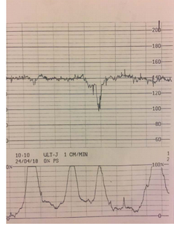
A deep isolated spontaneous deceleration may not be explained
merely associated to complete or partial cord blood compression. In
conclusion, once present, this FHR rate abnormality may represent
fetal compromise and thus careful supervision
A single episode
of spontaneous deceleration does not represent the indication for
immediate cesarean section, independent of the gestational age.

Slide 54
ممنون از همراهی تان

